Slide 1
Vertical and Horizontal High Q Testing – Lessons Learned for LCLS-II
Dan Gonnella
Cornell University
October 29, 2015

Slide 2
LCLS-II High Q R&D
3 Labs participated in R&D on High Q: Cornell, Fermilab, and JLab
This R&D consisted of:
Design of N-Doping recipe for Single and 9-Cell cavities
Testing of cavities vertically
Testing of fully dressed cavities horizontally
This work was meant to demonstrate feasibility and repeatability of N-doping for LCLS-II

Slide 3
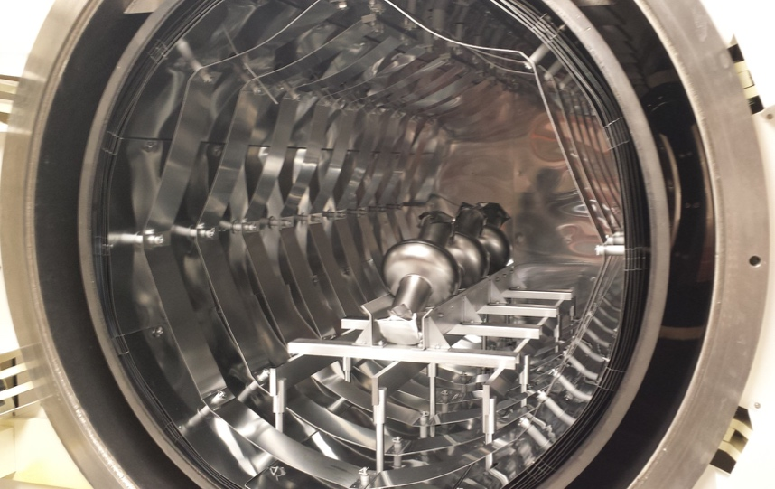
Cornell Results: Single-Cells
5 single-cells given same doping: 800ºC, ~60 mTorr N₂, 20 minutes + 30 minute anneal, followed by different EP (6-30 µm)

Slide 4
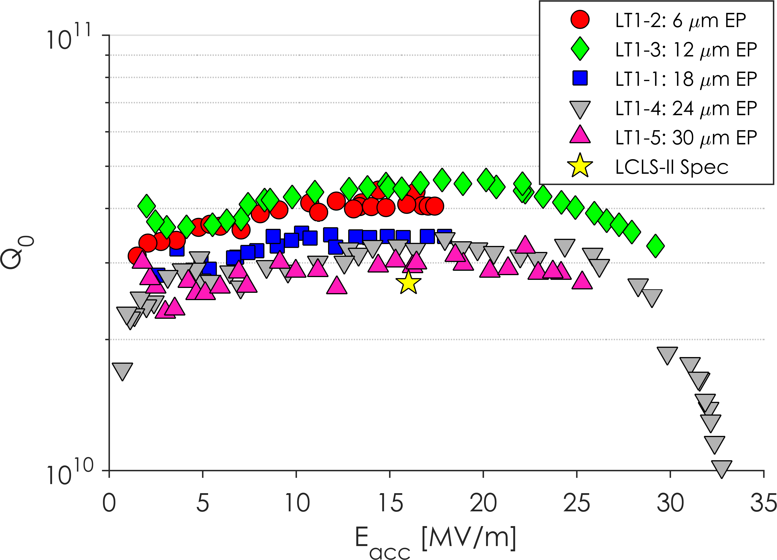
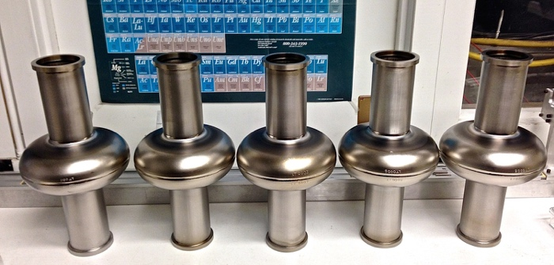
Cornell Results: Single-Cells
Average Q₀ at 2K: 3.6 x 10¹⁰ at 16 MV/m
Average max field:
27 MV/m
Far exceeding LCLS-II specs

Slide 5
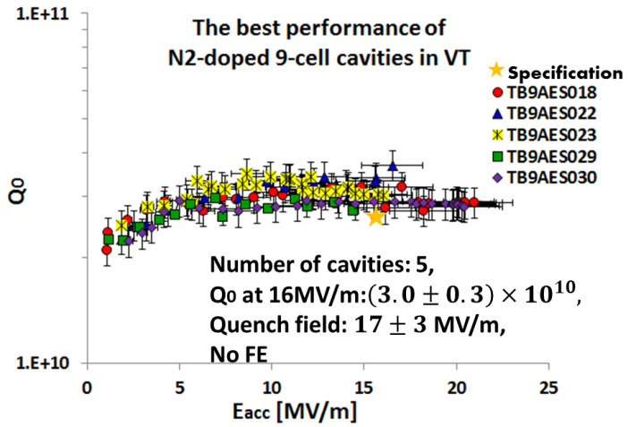
Cornell Results: 9 Cells
20N30 doping: 20 min N-doping + 30 min anneal at 800C
6N6 doping: 6 min N-doping + 6 min anneal at 800C
Average of Cornell N-doped 9-cell cavities
Q₀ at 16MV/m = (3.0 ± 0.3) x 10¹⁰
Quench field = 18 ± 3 MV/m
No field emission

Slide 6
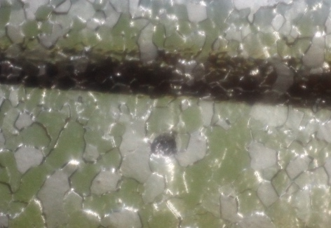
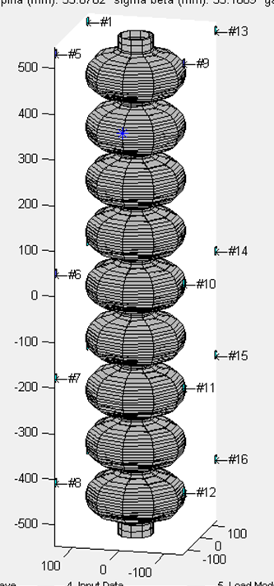
Effect of N-Doping on Quench Field
2N2-doped
Baseline, undoped
2K
-7 MV/m
Same quench location before and after doping
30% drop in quench field after doping
Doping model predicts 30% drop in lower critical field after doping (~130 mT => ~90 mT)!
Should expect: 32 MV/m XFEL quench field average => 22 MV/m LCLS-II doped cavity average

Slide 7
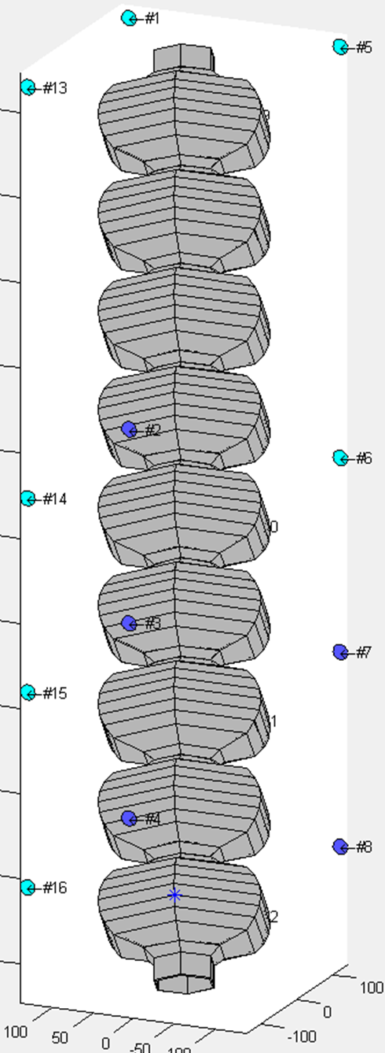
Effect of N-Doping on Quench Field
Heavy N2-dope
Light N2-dope
Baseline, no doping
2K meas.
RF surface | Qo at 16MV/m | Pi-mode limit
Heavy N2 dope (20/30) | 3.0e10 | Quench, 17MV/m
Baseline, no doping | 1.7e10 | Quench, 30MV/m
Light N2 dope (6/6) | 2.9e10 | Quench, 20MV/m

Slide 8
Cornell, FNAL, Jlab 9 Cell Results
9-Cell Performance after Short (2 min) Doping
Average quench field:
~22 MV/m!
Conclusion: Reduced lower critical field H_{c1} in N-doped cavities => earlier vortex penetration at defects => lower average quench field.

Slide 9
Field Emission
AES018
AES022
Two of Cornell’s 9-cell cavities were limited by FE after doping
One was fixed with just an additional HPR, the other with additional VEP (which did not change Q₀ performance)
Conclusion: Re-HPR and additional chemistry can be used if cavities are limited by field emission

Slide 10
Lessons for LCLS-II
Lesson 1: Nitrogen-Doping is sufficient to reach High Q – performance can be achieved reliably at the three labs
Lesson 2: We can expect an increase of 1 to 3 nΩ of residual resistance from VT to HT
Lesson 3: Large ΔT_{trans} and small ΔT_{long} are necessary to reach High Q in N-doped cavities
Lesson 4: Pressure in the furnace does significantly not affect nitrogen uptake in cavities
Lesson 5: Great care needs to be taken with auxiliary parts such as HOM couplers, input couplers, etc.

Slide 11
Vertical Test Procedures
Q₀ vs E_{acc} is measured at multiple temperatures:
Cornell measures each cavity from 1.6 to 2.1 K in 0.1 K increments
FNAL measures each cavity at 1.5 and 2.0 K
This allows one to decompose surface resistance in to residual and BCS portions
Cornell typically measured each cavity in a variety of cool downs with different cool down rates and external magnetic fields

Slide 12
Vertical Test Procedures
Cavities are assembled with high Q input couplers – this gives an easy and accurate measurement of the Q₀
Cornell uses variable couplers, FNAL and JLab use fixed couplers
Vertical test dewars have ~1 mG ambient magnetic field at all three labs
Cavities are typically cooled by dumping in liquid, resulting in very fast cool downs with large temperature gradients

Slide 13
Instrumentation and VT Summary
Item | Details
Temperature Sensors | At least 3 Cernox sensors on cavity cells
Fluxgate Magnetometers | At least two, one transverse, one longitudinal
Ambient magnetic field | <1 mG
Radiation Monitors | 1 outside the dewar under the shielding block (at Cornell)
Q₀ vs E measured at | 1.6, 1.7, 1.8, 1.9, 2.0, 2.1 K (Cornell)
Other items measured | Q₀ vs T, f vs T (Cornell)
Additional details | Multiple cool downs with different cooling rates and external magnetic fields (Cornell)

Slide 14
In Production
Item | Details
Temperature Sensors | At least 3 Cernox sensors on cavity cells Need at least 1
Fluxgate Magnetometers | At least two, one transverse, one longitudinal
Ambient magnetic field | <1 mG 5 mG?
Radiation Monitors | 1 outside the dewar under the shielding block (at Cornell) Do we need more?
Q₀ vs E measured at | 1.6, 1.7, 1.8, 1.9, 2.0, 2.1 K (Cornell)
Other items measured | Q₀ vs T, f vs T (Cornell)
Additional details | Multiple cool downs with different cooling rates and external magnetic fields (Cornell)

Slide 15
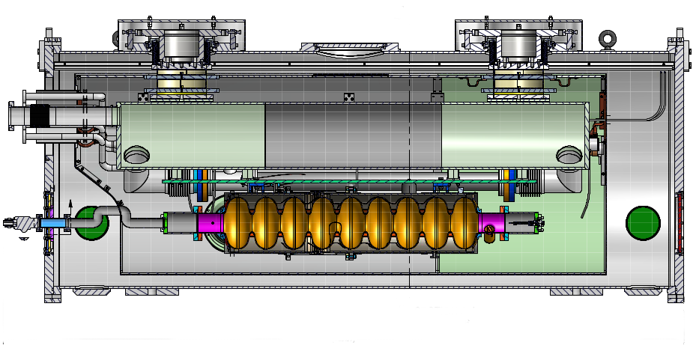
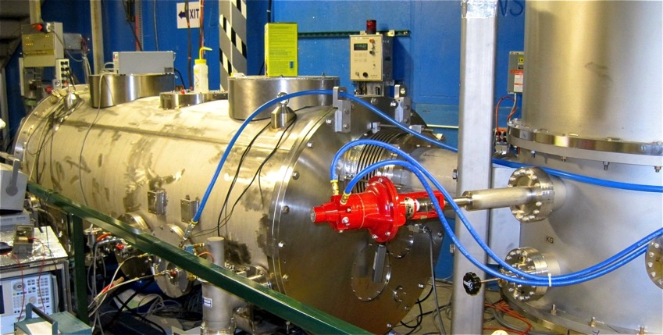
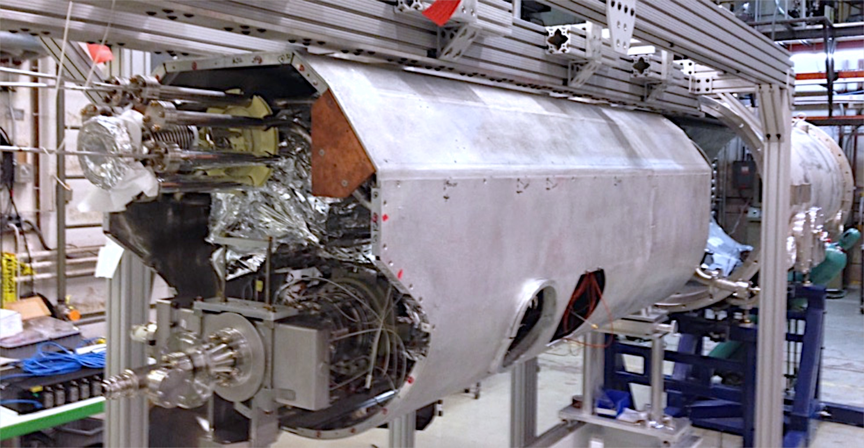
Cornell HTC Results
One-cavity test cryomodule
Short version of a main linac cryomodule
Same module construction (magnetic shields, cryogenic system…)
Dedicated to high Q₀ studies

Slide 16
Cornell HTC Results
Test | Cavity | Prepared By | RF Coupler | Helium Vessel | Other
HTC9-1 | ACC012 | FNAL | High Q | ILC
HTC9-2 | AES011 | FNAL | High Q | ILC
HTC9-3 | AES018 | Cornell | High Q | LCLS-II
HTC9-4 | AES018 | Cornell | LCLS-II | LCLS-II
HTC9-5 | AES030 | JLab | LCLS-II | LCLS-II | Tuner, HOM Couplers

Slide 17
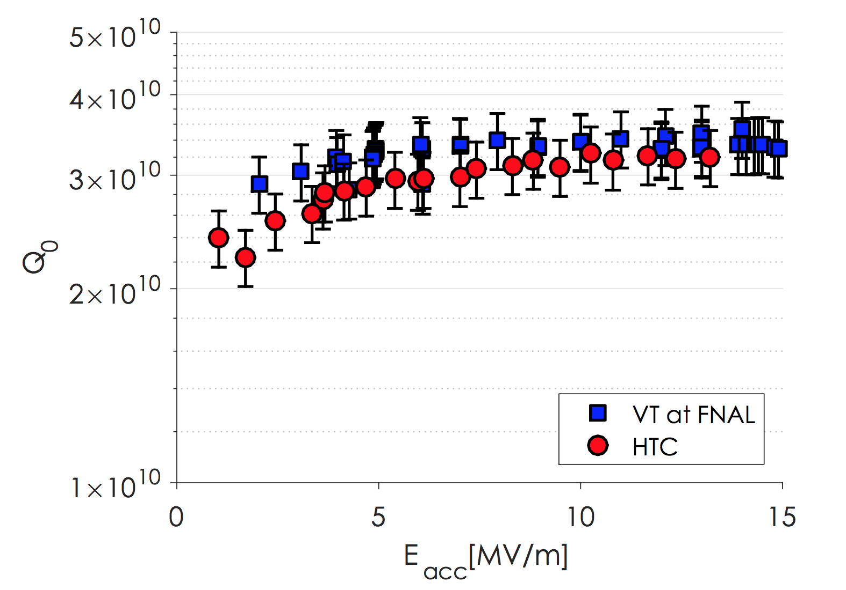
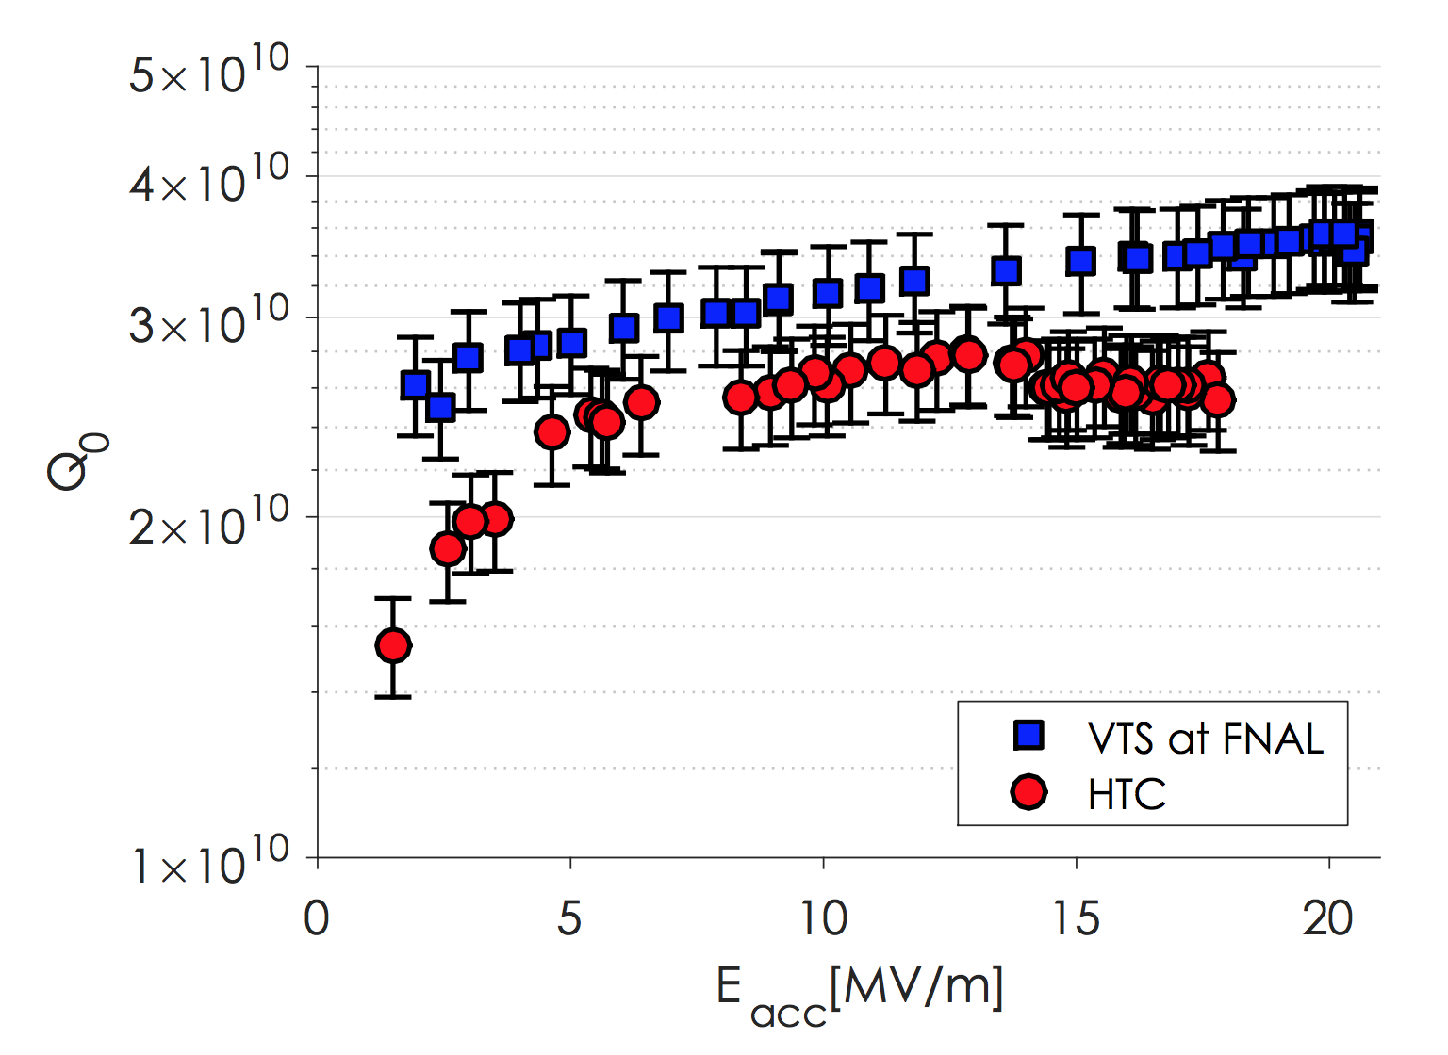
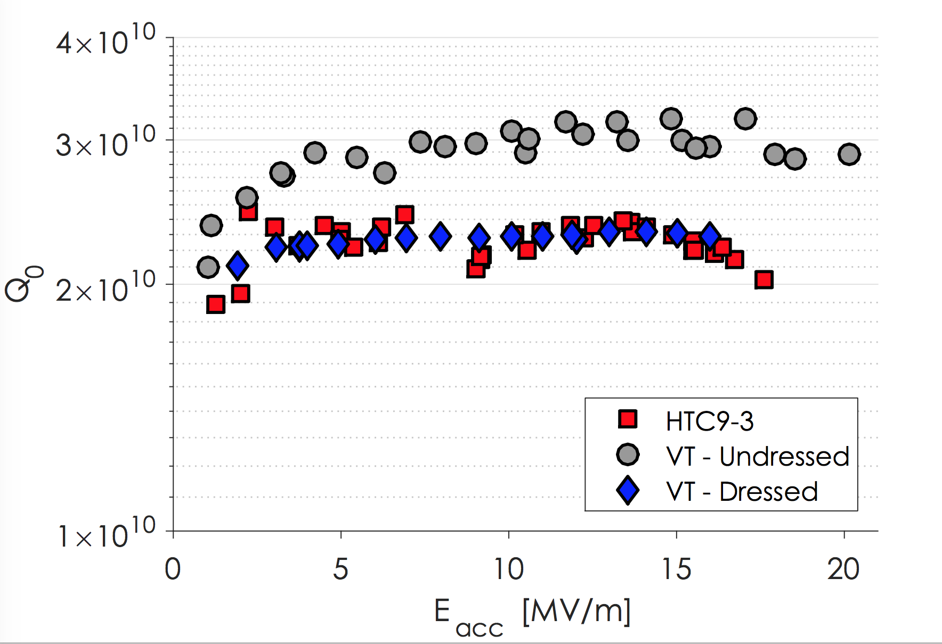
Cornell HTC Results
HTC9-1
HTC9-2
HTC9-3
2K
2K
2K
Cavity | Lhe Tank | HTC Test | VT Result | HT Result | ΔR_{VT->HT} [nΩ]
TB9ACC012 | ILC | HTC9-1 | (3.5±0.4)x10¹⁰ | (3.2±0.3)x10¹⁰ | 1 ± 2
TB9AES011 | ILC | HTC9-2 | (3.4±0.3)x10¹⁰ | (2.7±0.3)x10¹⁰ | 2 ± 2
TB9AES018 | LCLS-II | HTC9-3 | (2.2±0.3)x10¹⁰ | (2.2±0.2)x10¹⁰ | 0 ± 2
Conclusion: No significant change in performance when cavity is installed in cryomodule.

Slide 18
Cornell, FNAL, Jlab 9 Cell Results
Cavity ID# | 2K Q0 at 16 MV/m - vertical test, bare cavity [1E10] | 2K Q0 at 16 MV/m - vertical test, dressed cavity [1E10] | 2K Q0 at 16 MV/m - horizontal test [1E10] | Maximum accelerating field, latest test [MV/m] | ΔR - vertical bare to vertical dressed [nΩ] | ΔR - vertical dressed to horizontal dressed [nΩ]
ACC015 | 3.5 |  |  | 24.0
AES016 | 3.0 |  |  | 20.2
AES019 | 3.2 | 3.1 |  | 18.8 | 0.3
AES021 | 3.4 | 2.8 | 3.1 | 23.0 | 1.7 | -0.9
AES022 | 3.1 |  |  | 26.2
AES024 | 3.2 | 3.2 |  | 22.0 | 0.0
AES026 | 2.8 | 2.8 |  | 21.4 | 0.0
AES027 | 3.6 | 2.7 | 2.8 | 22.8 | 2.5 | -0.4
AES028 | 3.5 | 3.0 |  | 23.0 | 1.3
AES029 | 3.6 | 3.6 |  | 23.7 | 0.0
AES030 | 2.9 | 2.5 |  | 18.2 | 1.5
AES031 | 3.5 |  | 2.4 at 8 MV/m | 19.4
AES032 | 4.2 | 2.8 |  | 23.0 (admin limit) | 3.2
AES033 | 3.9 | 3.6 |  | 21.3 | 0.6
AES034 | 3.9 | 3.5 |  | 22.5 | 0.8
AES035 | 3.6 | 2.9 | 3.0 | 17.5 | 1.8 | -0.3
AES036 | 4.1 | 3.7 |  | 19.0 (admin limit) | 0.7
Average | 3.5 | 3.1 | 3.0 | 21.6 | 1.1 | -0.5
Conclusion: We see a 1 to 3 nΩ increase in residual resistance from bare VT to dressed HT
Should we increase the spec to 3.4x10¹⁰ in VT to meet 2.7x10¹⁰ in CM?
Notes:
Add prediction to VT spec to reach 2.7 HT

Slide 19
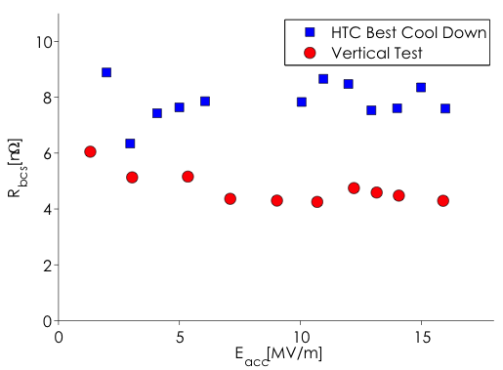
Decomposition of R_{s}
In HTC9-3, both BCS resistance and residual resistance changed from VT to HT
Should we be taking 1.6 and 2 K curves during production to identify which component of R_{s} potential issues are coming from?

Slide 20
HT Procedures
Q₀ vs E_{acc} is measured cryogenically due to low Q_{ext}, which is very time consuming
Cool downs are typically done by dumping in helium gas, which results in fast cool downs but with smaller temperature gradients than can be achieved in vertical test
Multiple cool downs completed to optimize flux expulsion and reach high Q₀

Slide 21
Instrumentation and HT Summary
Item | Details
Temperature Sensors | Cernox sensors distributed on the cavity cells, beam tubes, coupler, and HOM cans
Fluxgate Magnetometers | At least two, one transverse, one longitudinal
Ambient magnetic field | <3 mG
Radiation Monitors | On either side of the cryomodule
Q₀ vs E measured at | 1.6, 2.0 K
Other items measured | Q₀ vs T, f vs T (Cornell)
Additional details | Multiple cool downs with different cooling rates and external magnetic fields (Cornell)

Slide 22
In Production
Many Cernox sensors are impractical from a cost perspective – how many should we have?
Fluxgates are also expensive but we need at least one to measure magnetic fields
1.6 K and 2.0 K curves should be measured in order to better understand poor performance
Some cavities will not meet spec, understanding why is very important to solving that problem in future cavities
Temperature sensors on the HOM cans are highly recommended – will be discussed in detail later

Slide 23
Lessons for LCLS-II
Lesson 1: Nitrogen-Doping is sufficient to reach High Q – performance can be achieved reliably at the three labs
Lesson 2: We can expect an increase of 1 to 3 nΩ of residual resistance from VT to HT
Lesson 3: Large ΔT_{trans} and small ΔT_{long} are necessary to reach High Q in N-doped cavities
Lesson 4: Pressure in the furnace does not significantly affect nitrogen uptake in cavities
Lesson 5: Great care needs to be taken with auxiliary parts such as HOM couplers, input couplers, etc.

Slide 24
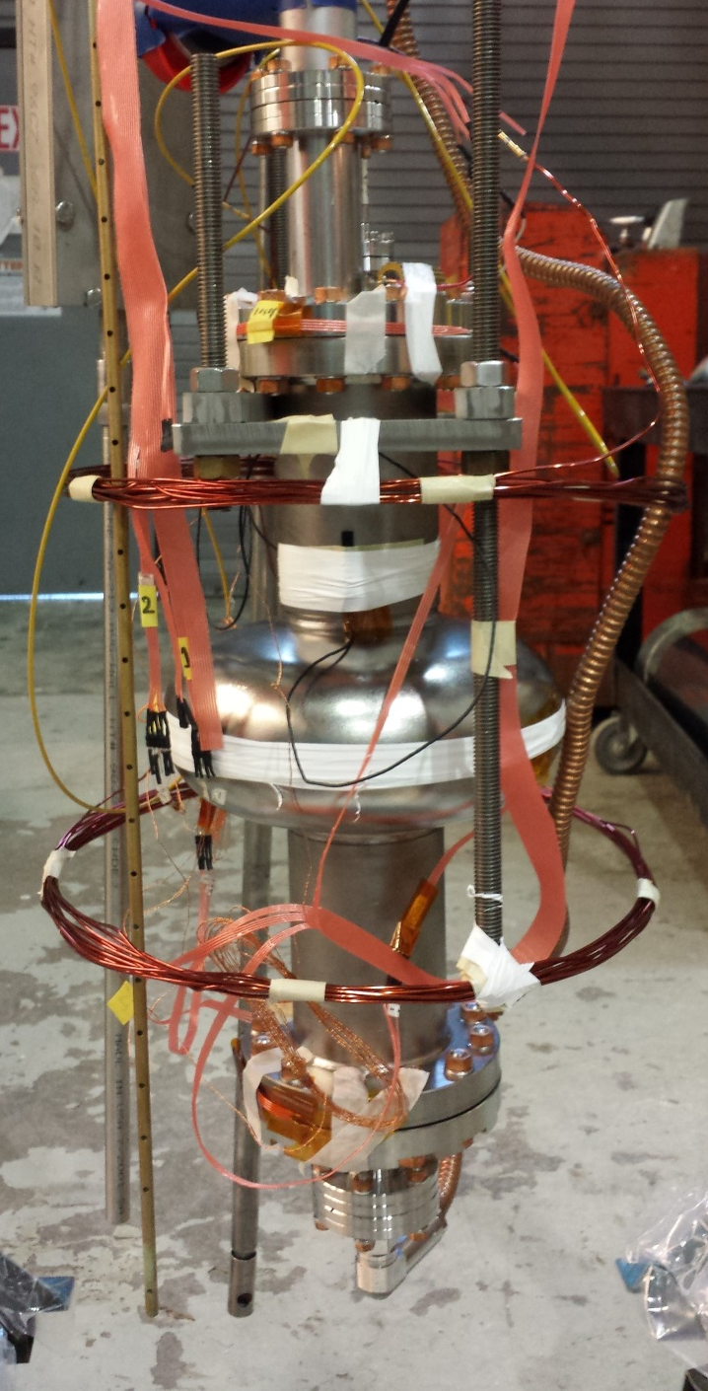
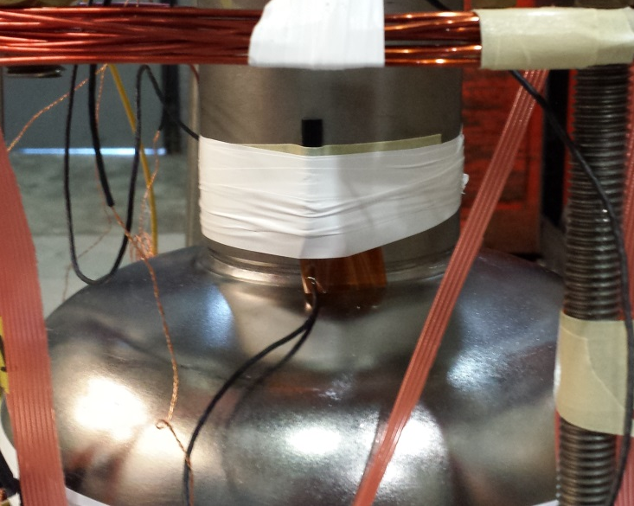
Magnetic Field Studies
Slow Cool
Down System
Temperature Sensors
Fluxgate
Magnetometer
Helmholtz
Coil

Slide 25
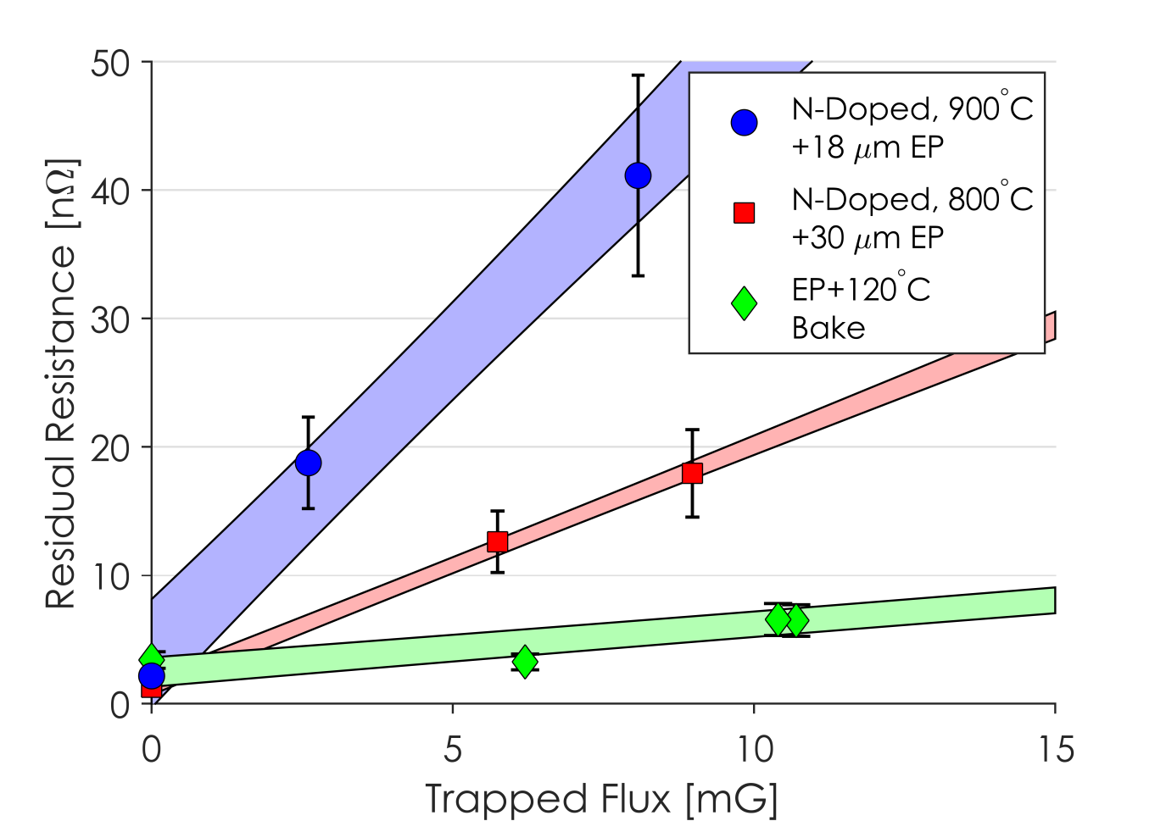
Magnetic Field Studies
Stronger doping results in a higher sensitivity to trapped flux.
Nitrogen-doped cavities showed a higher sensitivity than EP and EP+120ºC baked cavities.

Slide 26
Cool Down Studies
R_{res} vs ΔT_{vert}
R_{res} vs Helium Mass Flow Rate
Conclusion: Helium flow rates of >2 g/s needed for efficient magnetic field expulsion by vertical temperature gradients.

Slide 27
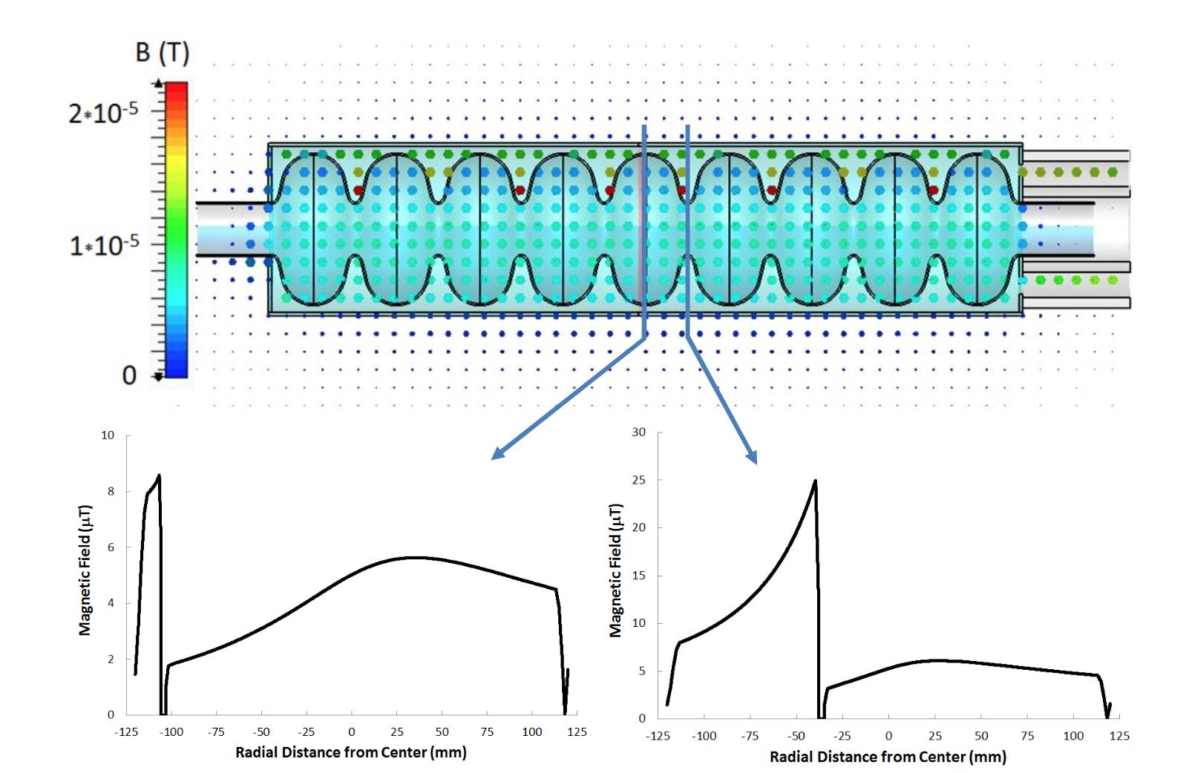
Cool Down Studies
ΔT_{horizontal}
Nb
i₂
Nb
Ti
Ti
ΔT_{vertical}
i₁
Cavity primarily cools from bottom to top => large ΔT_{vertical} in fast cool down
Good for efficient magnetic field expulsion
But: conductivity σ = σ(T) => Cylindrical symmetry is broken!
Finite ΔT_{horizontal} will drive thermal-electric currents with preferential flow through the bottom of the cavity
Non-zero magnetic field at the cavity inner surface
Ideal cool-down: large ΔT_{vertical} by fast cool down with small ΔT_{horizontal}
D. Gonnella et al., J. Appl. Phys. 117 , 023908 (2015)
R. Eichhorn, arXiv:1411.5285 [physics.acc-ph] (2014)
J.-M. Vogt et al., Phys. Rev. ST Accel. Beams 18, 042001 (2015)

Slide 28
Cool Down Studies
B_{trans} vs ΔT_{horiz}
R_{res} vs ΔT_{horiz}
Conclusion: Small horizontal temperature gradients <10K critical to keep impact of thermal-electric currents on R_{res} small.
The LCLS-II Helium vessel helps to minimize ΔT_{horiz}

Slide 29
Lessons for LCLS-II
Lesson 1: Nitrogen-Doping is sufficient to reach High Q – performance can be achieved reliably at the three labs
Lesson 2: We can expect an increase of 1 to 3 nΩ of residual resistance from VT to HT
Lesson 3: Large ΔT_{trans} and small ΔT_{long} are necessary to reach High Q in N-doped cavities
Lesson 4: Pressure in the furnace does not significantly affect nitrogen uptake in cavities
Lesson 5: Great care needs to be taken with auxiliary parts such as HOM couplers, input couplers, etc.

Slide 30
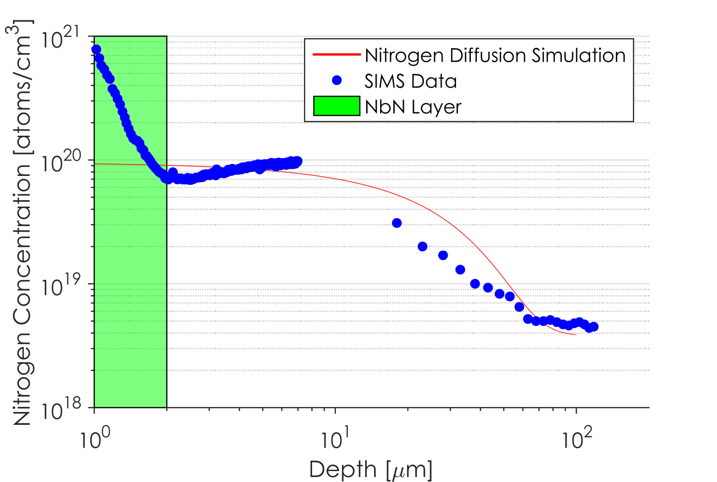
Diffusion Simulation
We have developed a diffusion simulation code that predicts nitrogen concentration in niobium based on doping parameters
Good agreement between measures interstitial nitrogen doping profile and diffusion model prediction.

Slide 31

Diffusion Simulation
Measured furnace pressure vs. time
Nitrogen uptake during doping is not dependent on pressure
Conclusion: Exact pressure in the furnace does not matter to achieve the same doping level
N2 gas injections into furnace
Drop in furnace pressure vs. time
$$dP∝dM_{N}∝\sqrt{time}$$

Slide 32
Lessons for LCLS-II
Lesson 1: Nitrogen-Doping is sufficient to reach High Q – performance can be achieved reliably at the three labs
Lesson 2: We can expect an increase of 1 to 3 nΩ of residual resistance from VT to HT
Lesson 3: Large ΔT_{trans} and small ΔT_{long} are necessary to reach High Q in N-doped cavities
Lesson 4: Pressure in the furnace does not significantly affect nitrogen uptake in cavities
Lesson 5: Great care needs to be taken with auxiliary parts such as HOM couplers, input couplers, etc.

Slide 33
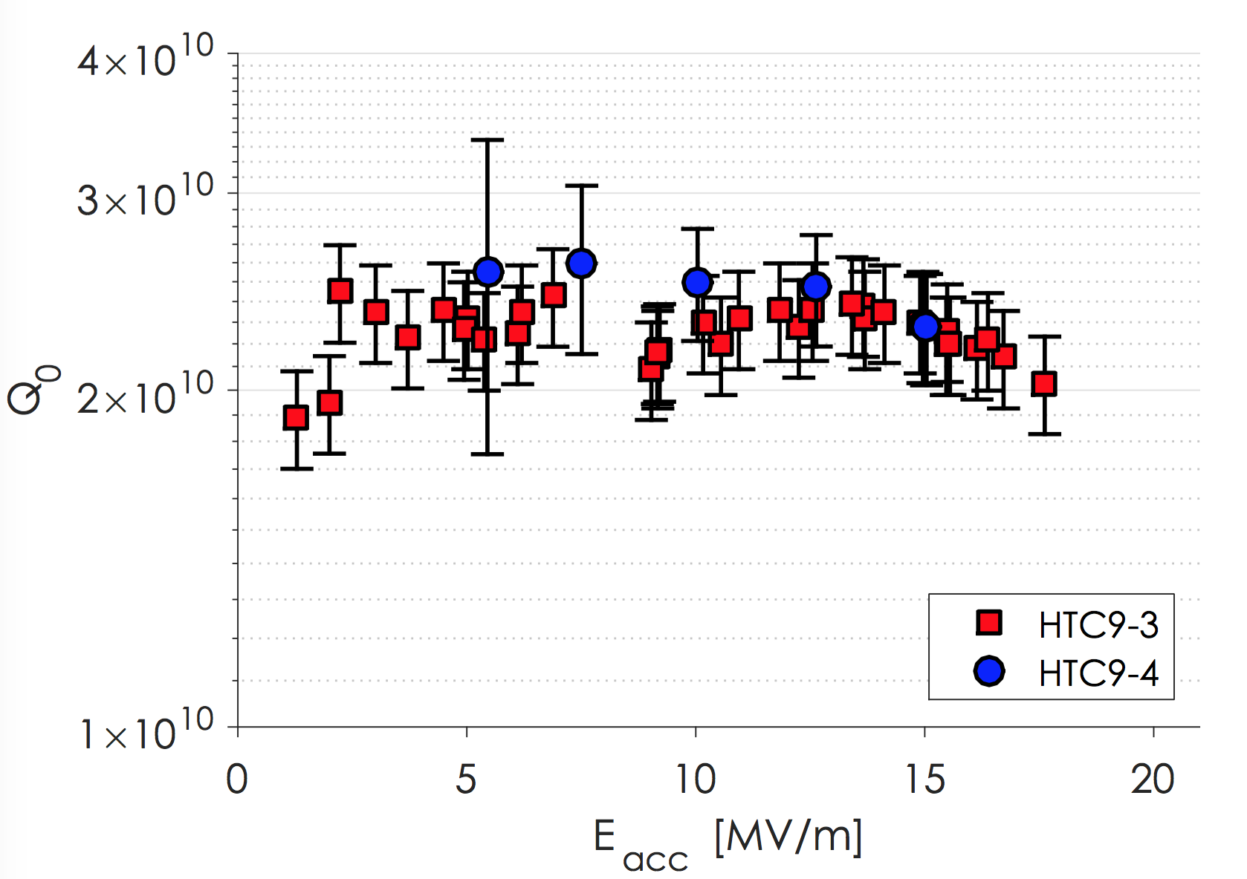
Impact of HPC on Q₀
HTC9-4: RF power coupler
Conclusion: No significant increase in 2K cryogenic load or cavity performance degradation from RF input coupler.
HTC9-3: high Q antenna
2K Q_{0,cryo} vs. RF power (under full reflection)
2K Q_{0,cryo} vs. Q_{ext}

Slide 34
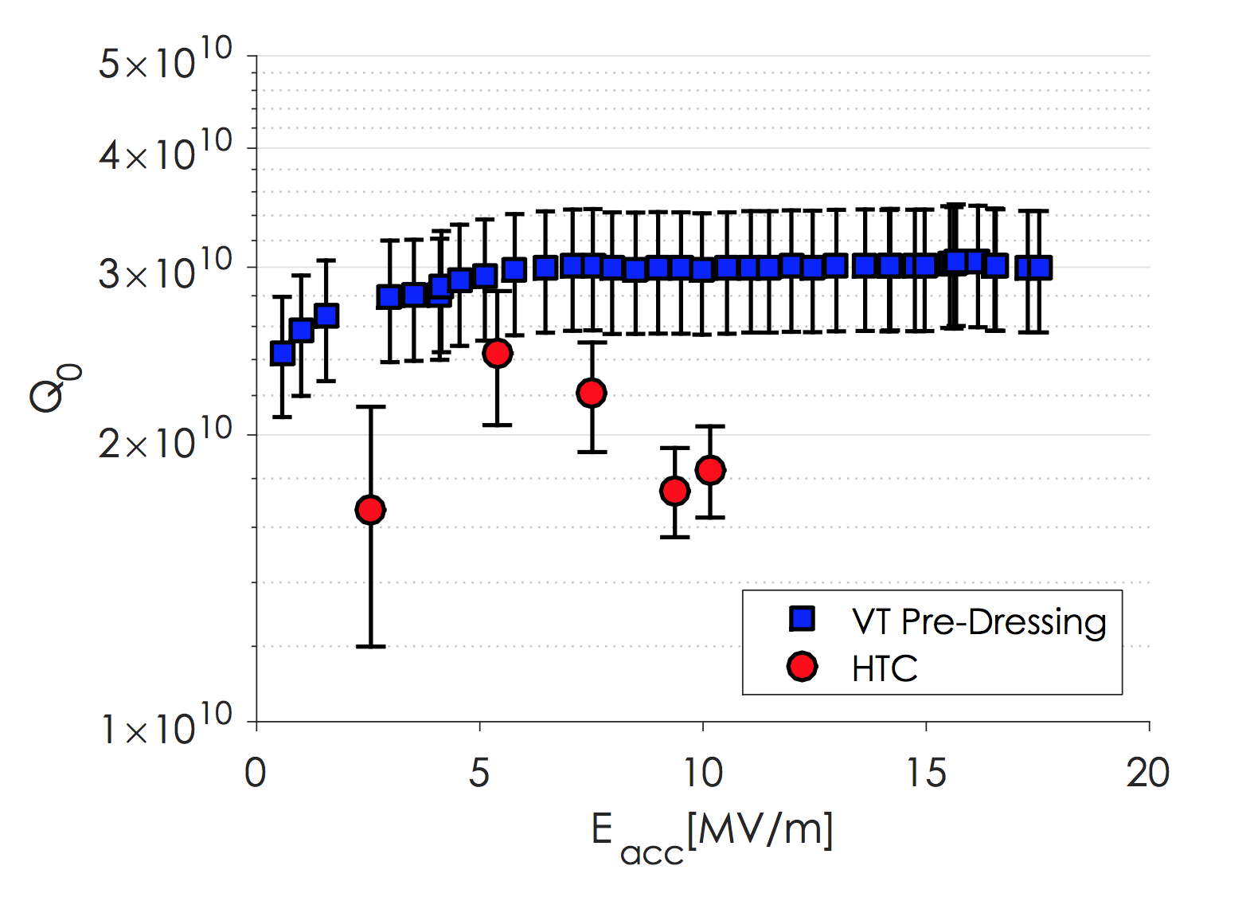
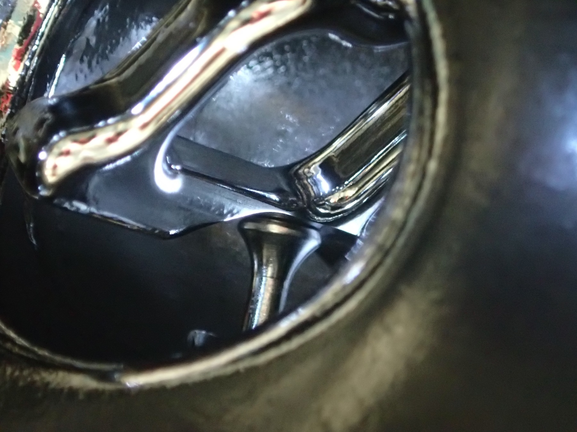
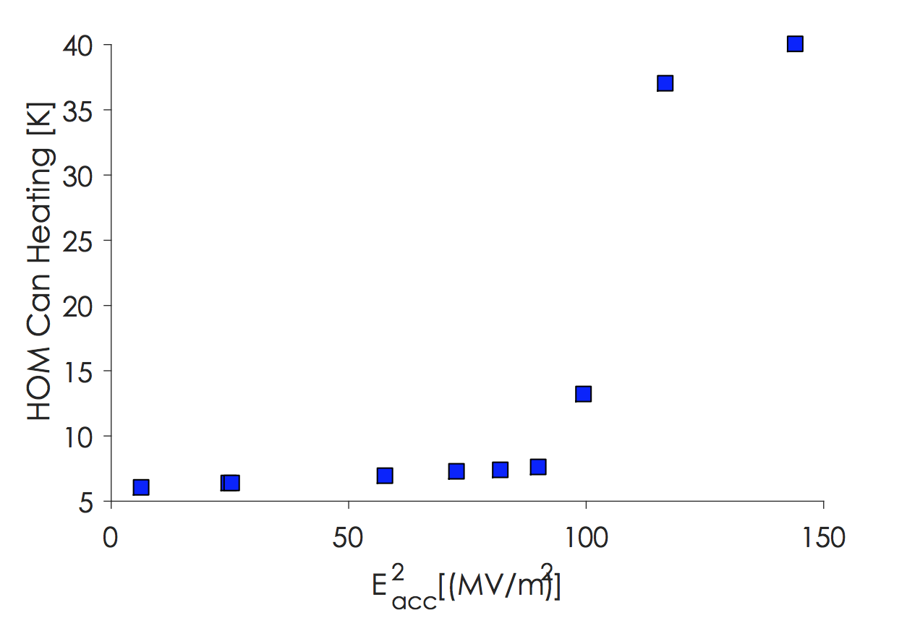
HOM Can Multipacting
Short (due to HOM can fabrication error) and multipacting in one HOM coupler resulted in significant heating and Q-slope
HOM can temp.
FNAL also observed this behavior but was able to condition it away

Slide 35
Lessons for LCLS-II
Lesson 1: Nitrogen-Doping is sufficient to reach High Q – performance can be achieved reliably at the three labs
Lesson 2: We can expect an increase of 1 to 3 nΩ of residual resistance from VT to HT
Lesson 3: Large ΔT_{trans} and small ΔT_{long} are necessary to reach High Q in N-doped cavities
Lesson 4: Pressure in the furnace does not significantly affect nitrogen uptake in cavities
Lesson 5: Great care needs to be taken with auxiliary parts such as HOM couplers, input couplers, etc.

Slide 36
Lessons for LCLS-II
Lesson 1: Nitrogen-Doping is sufficient to reach High Q – performance can be achieved reliably at the three labs
Lesson 2: We can expect an increase of 1 to 3 nΩ of residual resistance from VT to HT
Lesson 3: Large ΔT_{trans} and small ΔT_{long} are necessary to reach High Q in N-doped cavities
Lesson 4: Pressure in the furnace does not significantly affect nitrogen uptake in cavities
Lesson 5: Great care needs to be taken with auxiliary parts such as HOM couplers, input couplers, etc.

Slide 37
Main Takeaway
In every vertical and horizontal test, we encountered something unexpected – it is reasonable to assume that we will continue to experience this at the beginning of production

